Slide 1

New Trends in Energy Hydrogen and fuel cells
Constantinos Taliotis
taliotis@kth.se
Introductory lecture – Energy commodities and technologies
This work by OpTIMUS.community is licensed under the Creative Commons Attribution 4.0 International License. To view a copy of this license, visit http://creativecommons.org/licenses/by/4.0/.
Notes:
Good afternoon and welcome to the lecture on “…”.
Introduce yourself and your research, field of expertise

Slide 2
Motivation for energy technology research and development
Notes:
To start with, it’s important to understand why efforts are put into improving the structure of the current energy system. For instance, even in Sweden where the share of renewables is very high in comparison with the rest of the world (or even EU), there are efforts to transform the energy system into completely carbon free in the next few decades. This is not trivial, considering the fact that the transport sector is heavily reliant on oil products.

Slide 3
Why innovate?
Energy Efficiency – Cost Efficiency
The cheapest kWh is a kWh not generated
Making the best out of the available resources
Energy Security
Resilient and robust energy system
Taking advantage of domestic energy sources leads to reduced reliance on fuel imports
Climate Change
Transition to low-carbon economy
Health and environment
Reduced emission of air and water pollutants that adversely affect health
Notes:
>Moving on, one important aspect to improve on is energy efficiency, which directly corresponds to a more cost-efficient system. In terms of electricity generation, the cheapest kWh is a kWh not generated – this can be achieved for instance with better thermal insulation, thus reducing the need for heating or cooling.
>Furthermore, technology improvements help in strengthening the resilience and robustness of the energy system, as for example it can withstand outages more effectively. In addition, by maximizing the use of domestic energy sources, import dependency is reduced and disruptions in fuel supply and price fluctuations are avoided. For instance, EV owners charging their vehicles with electricity from domestic solar and wind technologies, remain unaffected in the case of sudden surges in oil price.
>In addition, future deployment of technologies that help reduce CO2 emissions is significant. Finally, emissions of air and water pollutants that adversely affect health public health and the environment can be reduced.
All of these aspects are connected to each of the technology options we will discuss today

Slide 4
Hydrogen and Fuel Cells
Notes:
Another technology option that is still under development is that of hydrogen and fuel cells.

Slide 5
Hydrogen and Fuel Cells
Fuel cell and hydrogen (FCH) technologies and applications are considered as potentially significant elements in a future low-carbon energy system in the medium- to long-term perspective.
Expected benefits are:
Mitigation of greenhouse gas emissions
Mitigation of local air pollution
High energy efficiency
Reduction of fossil fuel dependency
Promotion of technology exports
Notes:
Once they reach commercialization, H2 and FC technologies can play an important role in efforts to reduce GHG emissions in the long-term. Additionally, they reduce local air pollution, as at the point of use water is the only byproduct. FCH techs are more efficient than conventional fossil-fired combustion engines, while their use also tackles the aspect of fossil fuel dependency (and hence import dependency, if these are not domestically produced).
As a last point, countries that are production leaders (such as Japan, South Korea, US and Germany) can benefit financially through technology exports.

Slide 6
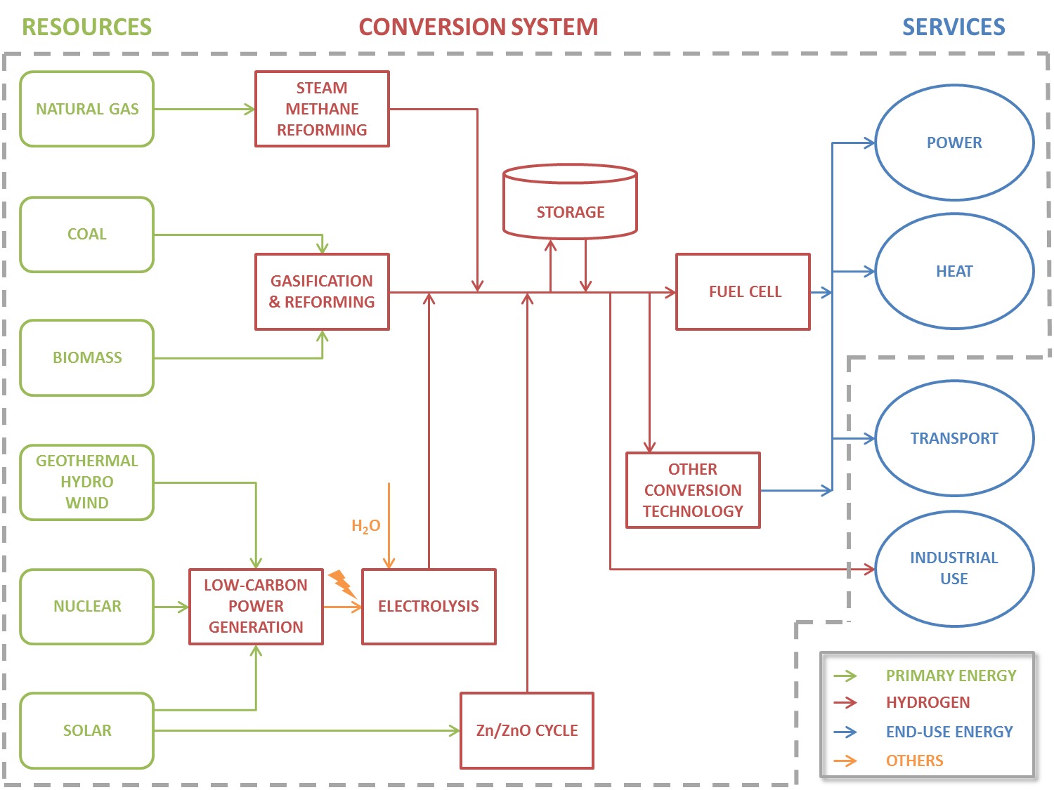
FCH Production and Use
Notes:
Hydrogen can be produced through a variety of methods. Steam methane reforming can be used to produce H2 from natural gas, while gasification and reforming is used to produced H2 from coal and biomass. In order to produce “low-carbon” H2, electricity from RET and nuclear can be used in electrolysis.
The zinc–zinc oxide cycle is a two step thermochemical cycle based on zinc and zinc oxide. In the first step concentrating solar power is used in which zinc oxide is thermally dissociated into zinc and oxygen (dissociation). In the second step zinc reacts with water and produces hydrogen and zinc oxide (in a process called hydrolysis).
Hydrogen can then be stored and used at a later stage. It can be put into a fuel cell and it can be burnt to generate electricity or heat. HFC can be used in the transport sector, while H2 can be used as input in industrial processes.
Since H2 can be stored and be fired at a later stage, it is important as a storage method in the case of vRE

Slide 7
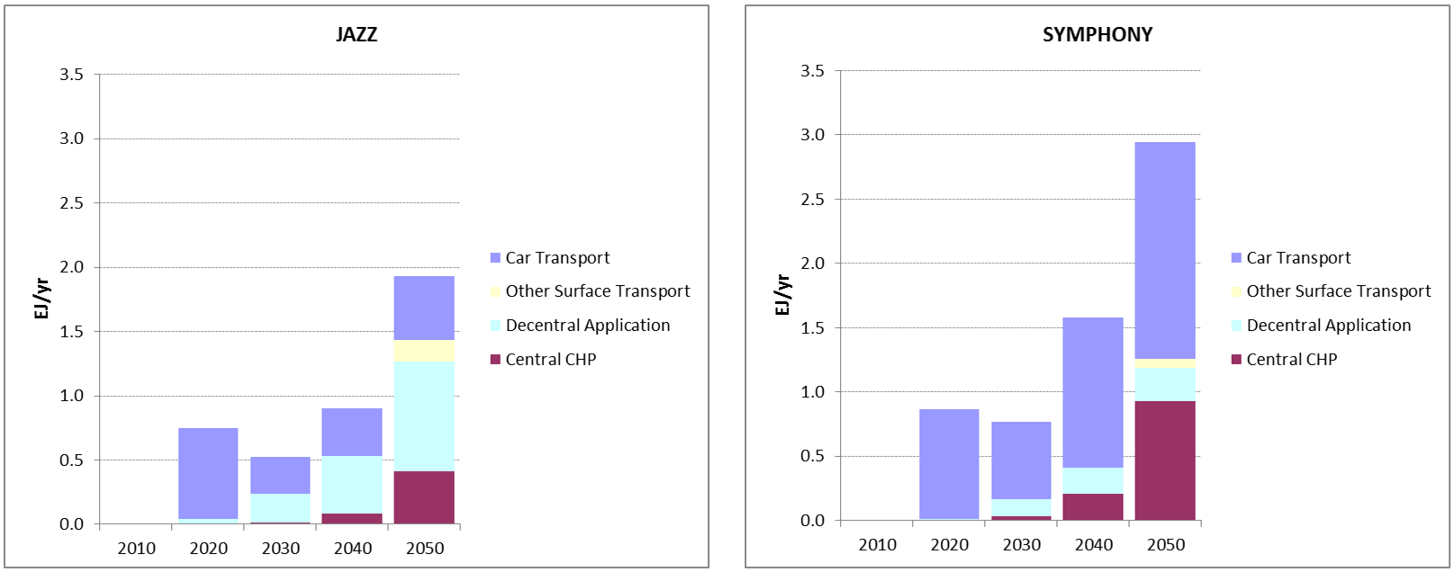
Hydrogen Scenario Analysis: Global
WEC/PSI scenarios “JAZZ ” and “SYMPHONY”
The share of hydrogen in the total final consumption is marginal:
JAZZ: from 0.13% in 2025 to 0.27% in 2050
SYMPHONY from 0.18% in 2025 to 0.50% in 2050
Source: WEC/PSI (2013)
Notes:
Again, due to the cost of FCH tech, it is important to look into global projections. Here we look at two scenarios from the World Energy Council and the Paul-Scherrer Institute.
Modern Jazz in 2060 is a world with a diverse set of resilient and lower-carbon energy systems. A highly complex and competitive market landscape drives efficiency, innovation, open access to information and rapid deployment of new technologies.
Unfinished Symphony by 2060, the world is “ticking on the same clock” and has shifted to a resilient, integrated, global low-carbon energy system. There is global unified action on security, environmental and economic issues, and global institutional and national governments support enabling technologies.

Slide 8
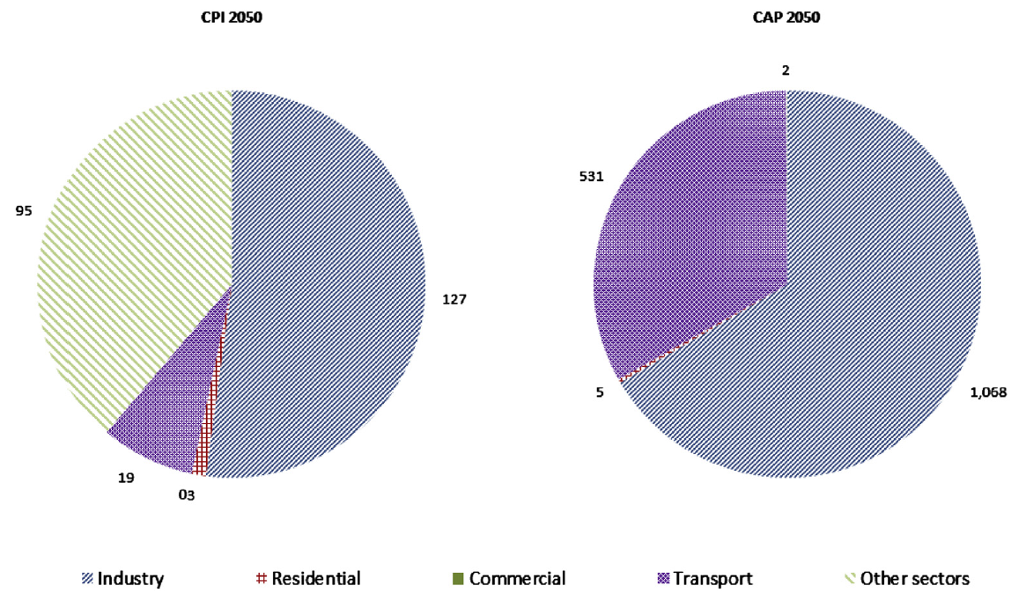
Hydrogen Scenario Analysis: Europe
JRC EU-TIMES scenarios “CPI” and “CAP”
The share of hydrogen in the total final consumption is small:
CPI: very small amounts
CAP: from 1% in 2030 to merely 4% in 2050
CPI 2050
(~250 PJ H₂)
CAP 2050 (~1600 PJ H₂)
Source: Sgobbi et al. (2016)
Notes:
Since European countries are market leaders in developing this technology, the outlook differs slightly from the corresponding global.
Under two climate scenarios, current policy initiative (CPI) and long-term decarbonisation (CAP)

Slide 9
Hydrogen Scenario Analysis: UK
E4Tech/UCL scenarios “Critical Path” and “Full Contribution”
The share of hydrogen in the total final energy:
“Critical Path”: 1% in 2040
“Full contribution”: 60% of residential buildings and 50% of the industry sector supplied by H₂ in 2050; similar for services
Source: Hart et al. (2015)
Notes:
In the case of UK two scenarios were investigated in a recent publication.
The Critical Path scenario is based on keeping open the option to use hydrogen in end-uses that are seen to be ‘strategically important’. Specifically, ‘strategically important’ end-use demands are defined here as demands that are hard to decarbonise by means other than hydrogen, or for which low-carbon options other than hydrogen are less obviously available.
The Full Contribution scenario is an aggressive hydrogen uptake scenario characterised by early, consistent and long-term commitment to the extensive use of hydrogen across the economy. It is driven by an early decision to decarbonise heat provision across the UK by delivering hydrogen using existing infrastructures, and this subsequently provides some of the infrastructure for FCEV adoption in the transport sector.

Slide 10
Hydrogen Scenario Analysis: Conclusions
Insights from the scenario studies
Significant deployment of H₂ (>10% of final energy consumption) is probably in the post-2025 period (if at all).
The scenarios with large deployment of H₂ have two features:
Strong uptake in the transport sector
High carbon price
A strategic positioning towards H₂ is needed for larger deployment.
Notes:
The 3 studies that have been shown for H2 indicate that:
(the 3 bullet points)

Slide 11
Changelog and attribution
Date | Author | Reviewer | Reviser
2017-10-10 | Constantinos Taliotis | Agnese Beltramo | Constantinos Taliotis
To correctly reference this work, please use the following:
Taliotis, C., 2017. New Trends in Energy – Hydrogen and fuel cells, OpTIMUS.community. Available at: http://www.osemosys.org/understanding-the-energy-system.html. [Access date]

